Slide 1
Maven – The Knowledge Sharing Platform Oracle Retail Solution Overview Day 2 (13th April 2012) Dinesh Mohata

Slide 2
Agenda
Oracle Retail Architecture
Integration Strategy & Approach
LSIPL Landscape
Rollout Approach & Solution Landscape
Data Migration Approach
Notes:
2

Slide 3
RMS - ReSA Application Architecture
The following diagram illustrates the various components involved and the protocols used for communication

Slide 4
Oracle Retail - RMS & Resa Application Architecture
There are several key concepts to take away from the above diagram:
RMS and ReSA uses Application Server Forms & Reports 3 Tier architecture ,client Tier, middle Tier and Database Tier
Client Tier contains the Web browser and resides in client desktop
Middle Tier is the application server, where application logic and server software are stored.
Database Tier the database server, where enterprise data is stored
The architecture is very server centric.
When the user opens the RMS & ReSA applications from the desktop through the web browser for the first time , oracle JInitiator gets downloaded into client desktop
Oracle JInitiator provides a delivery mechanism for an Oracle certified JRE, which enables Oracle Forms applications to be run from within a browser in a stable and supported manner

Slide 5
Oracle Retail – ORSIM Application Architecture
Presentation Layer – Java SWING based JRE 1.4.2 …
Application Layer
– Oracle Application Server requiring OC4J instance
– Authentication using Oracle Internet Directory (OID)
– Wavelink Studio
Database Layer – Oracle 10g

Slide 6
Oracle Retail – ORWMS Application Architecture
Presentation Layer – Java Compatible Web Browser , Jinitiator 1.1.8.x
Application Layer – Oracle 9iAS (Web +Wireless) including Forms Services, Report Services , HTTP Server
Database Layer – Oracle RDBMS 9i Enterprise Edition

Slide 7
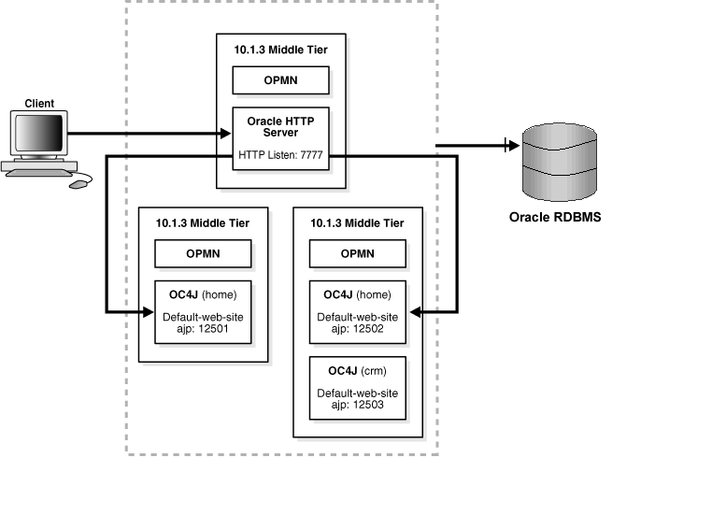
Oracle Retail – RPM,Allocation & Reim Application Architecture
The following diagram illustrates the various components involved and the protocols used for communication

Slide 8
Oracle Retail – RPM Application Architecture
There are several key concepts to take away from the above diagram:
RPM uses Applicaton Server j2ee and webcache 3 Tier architecture ,client Tier,middle Tier and Database Tier
RPM client side code runs in a WebStart Java Virtual machine instance, while its server side code runs in the Oracle Application Server and accesses an Oracle Database server
RPM needs a separate OC4J group and OC4J instance to be created
RPM database objects are installed in RMS database schema
rpm_client_config.jar jar file , user must sign this jar file after the installation has completed, before opening up the application

Slide 9
Oracle Retail – ReIM Application Architecture
ReIm uses Applicaton Server j2ee and webcache 3 Tier architecture ,client Tier,middle Tier and Database Tier
ReIm needs a separate OC4J group and OC4J instance to be created
ReIm database objects are installed in RMS database schema
ReIm.properties file contains most of the settings for the ReIM application

Slide 10
Oracle Retail Data Warehouse Application Architecture
Establish a partitioning strategy before creating compressed Data Mart and historical tables in a RDW environment
Separate set of RDW Schema Owners are created in RDW DB
RDW incorporates RETL
RDW needs TIME data extracted from RMS
Oracle Retail Data Warehouse 13.1 can be deployed using Oracle Business Intelligence Enterprise Edition (OBIEE) or Oracle
Oracle BI Client tools are required for the power user like the developers for customizing any repository

Slide 11
Oracle Retail – Allocation Application Architecture
Allocation uses Applicaton Server j2ee and webcache 3 Tier architecture ,client Tier,middle Tier and Database Tier
Allocation needs a separate OC4J group and OC4J instance to be created
Allocation database objects are installed in RMS database schema
Calculation Server and Algorithms
The algorithm files are installed under J2EE_HOME/calc
To start,stop and see status the calculation queue, respectively, run the following commands in
J2EE_HOME/calc:
./queue.sh start 1
./queue.sh stop 1
./queue.sh status 1

Slide 12
Oracle Retail Integration Bus (RIB)

Slide 13
Oracle Retail Integration Bus (RIB) Application Architecture
The RIB is configured and deployed to the Oracle Application Server
RIB has 5 basic components
PUBLISHING adapters create messages from the information captured by the applications eg (RMS)
SUBSCRIBING adapters are used to consume messages
TRANSFORMATION Address Filters/Router (TAFR) adapters transform message data and route messages
RIB Database Objects are Oracle objects and tables to support the PL/SQL stored procedures that are called by the Publishing and Subscribing Adapters. They are part of a specific PL/SQL Oracle Retail application, such as RMS,RWMS etc.,
RIB Hospital database tables are used as a basis for storing and re-trying problematic messages

Slide 14
Oracle Retail Component Overview
Database Server
A relational database management system (RDBMS) that acts as the repository for all information managed by a oracle Retail application
Oracle 11G
Batch Server
Your batch server uses third party tools AppWorx or Ctrl M that runs your oracle Retail batch processes.
Oracle Retail batch processes consists of as sql,plsql,shell scripts,poc*c ,which are scheduled and invoked by a Scheduler server.
The batch server maintains connectivity to the database.

Slide 15
Integration Strategy
Purpose
To effectively implement an integrated applications architecture, a comprehensive understanding of the integration requirements and a sound decision framework is needed with regard to the methods of integration available and how to choose a method which will best suit each situation.
Supply background information on some of the concepts and technologies involved.
Outline the alternative methods of integration available.
Provide a decision framework for how to compile an end-to-end integration solution.
Discuss the generate approach for the Projects integration requirements.

Slide 16
Integration Alternatives
Manual Process
Where data volumes are low, speeds are not critical and transfers infrequent the use of manual processes can be the most cost effective solution.

Slide 17
Integration Alternatives
Direct Point to Point
Some Commercial software applications include, or have separately available for them, a programming tool which can be used to integrate the application directly to other applications or systems.

Slide 18
Integration Alternatives
File-based Integration
File-based integrations provide the ability to exchange files with third-party systems or legacy systems that do not support messaging.

Slide 19
Integration Alternatives
Extract, Transformation, Load (ETL)
The concept of an ETL interface is to use a connector to extract data from an application, use another process to perform transformation and then a further connector to load the data into a separate application.

Slide 20
Integration Alternatives
Message Oriented Middleware (MOM)
Messaging is a concept whereby one atomic data unit is sent in an encapsulated package via a secure and reliable medium to enable the communication between disparate applications. MOM provides the infrastructure (Message transport Layer) to support this.

Slide 21
Integration Alternatives
Message Broker
By using a Message Broker with the Message Transport Layer, data can be transformed from the format provided by one application into that required by another. The Message broker can also act as a common integration hub to which all applications can pass data to and which itself can then route messages and reduce the huge number of interfaces and repetition of functionality compared with point-to-point connections.

Slide 22
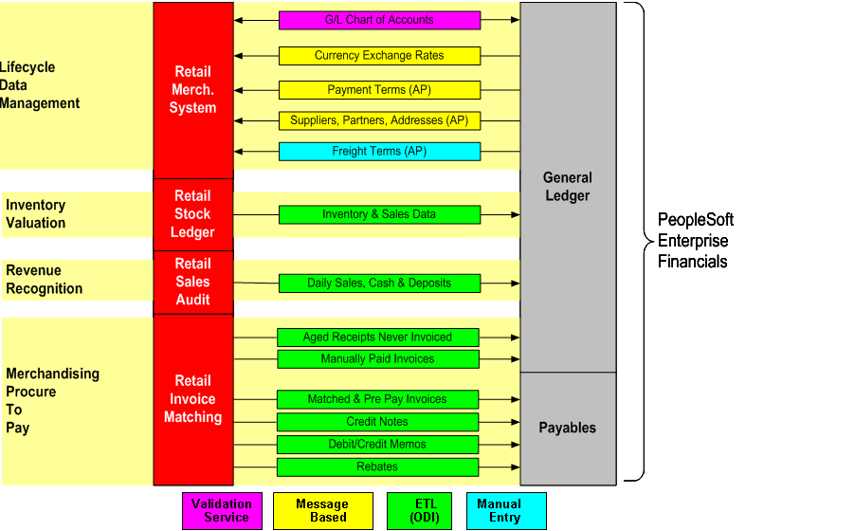
Oracle Retail Integration Option
Oracle Retail Merchandising Integration Pack for PeopleSoft Financials
Oracle offers customers a pre-configured, supportable and upgradeable integration of the retail merchandising execution applications with the financial operation control applications. This integration pack is part of an overall strategy to provide a comprehensive solution footprint for the retail industry based on Oracle’s best of breed applications, which is Application Integration Architecture (AIA)

Slide 23
Oracle Retail Integration Option
Retail Integration Bus (RIB)
The Oracle Retail Integration Bus (RIB) is a fully distributed integration infrastructure that uses Message Oriented Middleware to integrate applications. RIB enables various Oracle Retail applications to integrate in an asynchronous and near real time fashion. RIB provides additional value added business and infrastructure services to the Oracle Retail applications in addition to providing integration connectivity.
Retail Service Layer (API)
RSL provides a synchronous interface between a client application and a server application. The client application typically runs on a different computing host from the service. However, RSL allows for the service to be called internally in the same program or Java Virtual Machine as the client, without the need for code modification. RSL works within the J2EE framework. All services are contained within an interface offered by a stateless session bean. To a client application, each service appears to be merely a method call.
Pro*C (File Based)
Embedded SQL is a method of combining the computing power of a high-level language like C/C++ and the database manipulation capabilities of SQL. It allows you to execute any SQL statement from an application program. Oracle's embedded SQL environment is called Pro*C. A Pro*C program is compiled in two steps. First, the Pro*C precompiler recognizes the SQL statements embedded in the program, and replaces them with appropriate calls to the functions in the SQL runtime library. The output is pure C/C++ code with all the pure C/C++ portions intact. Then, a regular C/C++ compiler is used to compile the code and produces the executable
Retail Extract, Transform and Load (ETL)
The Retail Extract Transform and Load (RETL) is a high-performance runtime tool useful in parallel processing systems where high volumes of data must be processed quickly. By incorporating RETL into an application, the amount of time required to process data from databases and flat files may be reduced.

Slide 24
Additional Oracle 10G Database Integration Options
SQL *Loader / Oracle Data Pump
SQL*Loader is the primary method for quickly populating Oracle tables with data from external files. It has a powerful data parsing engine that puts little limitation on the format of the data in the datafile. SQL*Loader is invoked when you specify the sqlldr command or use the Enterprise Manager interface
Oracle Data Pump is a feature of Oracle Database 10g Release 2 that enables very fast bulk data and metadata movement between Oracle databases. Oracle Data Pump provides new high-speed, parallel Export and Import utilities (expdp and impdp) as well as a Web-based Oracle Enterprise Manager interface.
PL/SQL
PL/SQL is an imperative 3GL that was designed specifically for the seamless processing of SQL commands. It provides specific syntax for this purpose and supports exactly the same datatypes as SQL. Server-side PL/SQL is stored and compiled in Oracle Database and runs within the Oracle executable. It automatically inherits the robustness, security, and portability of Oracle Database. Many customers allow client code to access Oracle Database only by calling PL/SQL subprograms. This approach not only reflects generic modular programming best practices (define a clean, functional API and hide the implementation); also, it typically drastically reduces network round trips between the client and Oracle Database.
Oracle Transparent Gateways
Gateways make it possible to integrate with any number of non-Oracle systems from an Oracle application. They enable integration with data stores such as DB2, SQL Server and Excel, transaction managers like CICS and message queuing systems like WebSphere MQ Will allow you to access data from a multitude of sources.

Slide 25
Integration Considerations
Existence of current interface solutions
Data volumes
Speed of data transfer
Data transfer frequency
Complexity of data transformation
Criticality of Data
Application standard programs
Commonality of data transfer (# of receiving applications)
Overall cost of integration
Susceptibility to change
Inter-Enterprise communications (3rd Party)
Assurance Method

Slide 26
Integration Approach 1
Enterprise
Staging
Layer
Data from LS
API
SQL Loader
PL/SQL
RETL
RMS
e.g. XX_SUPS
XX_SUPS_ARCH
Notes:
--Framework of Migration
--Migration Architecture
--Interface
--Integration

Slide 27
Integration Approach 2
Legacy Staging
Layer
OR
Staging
Layer
Data from LS
RMS
SQL Loader
PL/SQL
DB Link
API
SQL Loader
PL/SQL
RETL
Notes:
--Framework of Migration
--Migration Architecture
--Interface
--Integration

Slide 28
Integration Approach 3
Staging
Layer
Data from LS
Egate – Custom E-way
RMS
Notes:
--Framework of Migration
--Migration Architecture
--Interface
--Integration

Slide 29
LSIPL – Current Landscape
Masters & Transactions
MIS
Vendor
VRF
Masters
COPS
Server
Pool server
APPS
WEB Reports
Situated at Corporate Office
Client
Client
CRM
WH
Masters & PO
Masters & PO
GVTS
COPS- Central Order processing system
LANPOS – Landmark Point of sale
BOSS- Back office Stock & Sales system
Inventory-Transactions…
- Mgrn , SGRN, STN & PRN
- Sales & Customer Return
GVTS-Gift voucher tracking system
Transaction at LANPOS..
- Sales & Redemption
Transaction at GVTS..
- Issues, pooling the data from
LANPOS
CRM - Loyalty Program
Pooling the data from LANPOS
to calculate customer points
BOSS
Server
Stores
Client
Client
Client
Sales
Inventory
Masters
LANPOS
Server
POS
POS
POS
Billing

Slide 30
Oracle Retail Products For Rollout
ALLOCATION
BUSINESS INTELLIGENCE
Oracle Retail Allocation -ORA
Oracle Retail Data Warehouse -ORDW
COMMERCIAL
FINANCE
Oracle Retail Merchandise System -ORMS
Oracle Retail Price Management -ORPM
DISTRIBUTION-SC
Oracle Retail Warehouse Mgt System -ORWMS
FINANCE
Oracle Retail Sales Audit -OReSA
FINANCE
Oracle Retail Invoice Matching -OReIM
STORE
Oracle Retail Central Office -ORCO
STORE
Oracle Retail Store Inventory Mgt-ORSIM
Oracle Retail Back Office -ORBO
Oracle Retail Point Of Service-ORPOS
Plan & Control
Commercial
Store
Distribution
Finance
Notes:
30

Slide 31
Oracle Retail Rollout Approach
Legacy Systems
Warehouse
(LocalServer)
Stores
Corporate Order Processing
System (COPS)
Back office Sales &
Support System (BOSS)
Store (Legacy POS / LANPOS
& BOSS system)
Warehouse Back
Office Sales &
Support System
(BOSS)
Store (Legacy POS / LANPOS
& BOSS system)
Temporary / Throwaway
Interfaces
Store (Legacy POS / LANPOS
& BOSS system)
New Solution stack
Store (Legacy POS / LANPOS
& BOSS system)
Oracle Retail Merchandising
Oracle Retail Pricing
Oracle Retail Invoice Matching
Warehouse
(LocalServer)
Store (Legacy POS / LANPOS
& BOSS system)
Oracle Retail Trade Management
Oracle Retail Allocation
Oracle Retail Sales Audit
Oracle Retail Warehouse Management System (ORWMS)
Store (Legacy POS / LANPOS
& BOSS system)
Oracle Retail Data Warehouse
Oracle Retail Integration Bus
Oracle Retail Service Layer
Oracle Business Intelligence Enterprise Edition
Stores
Store
(OSIM & ORPOS)
Existing/Legacy
Store
(OSIM & ORPOS)
New Oracle

Slide 32
Integration Touch Points
Discuss the various Oracle Retail related interfaces with Legacy System/s
Between COPS & Oracle Retail
Warehouse Transfer between BOSS & OR
Item Interface
MH & OH Interface
Finance & OR

Slide 33
Interface Matrix
Activity | RMS | RWMS | SIM | ReIM | Legacy | ORFIN
Module
Payment Terms | a |  |  |  |  | a
Chart of Accounts (COA) | a |  |  |  |  | a
Currency – Exchange Rate | a |  |  |  |  | a
Stock Ledger | a |  |  |  |  | a
Supplier | a |  |  |  | a | a
Payments |  |  |  | a |  | a
MH/OH | a |  |  |  | a
Item Details | a |  |  |  | a

Slide 34
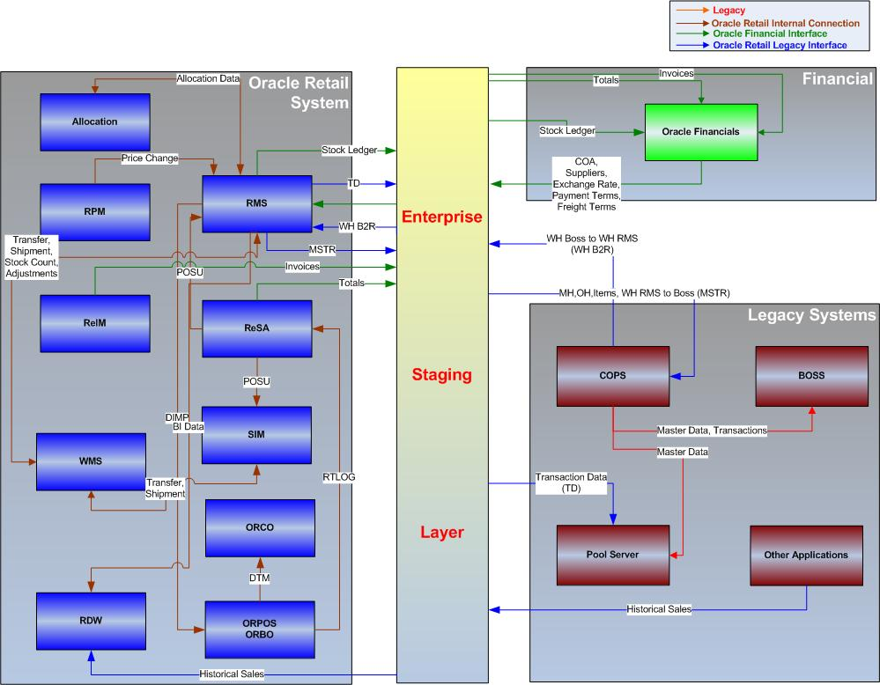
Interface Diagram

Slide 35
Application Sun Setting
Application | P1 (02-Apr-2011) | P2 (15-May-2011) | P3 (15-Jun-2011) | P4 (To be Planned)
Oracle Retail | P | P | P | P
BOSS | P | P | O | O
COPS | P | P | O | O
Pool Server | P | P | P | O
GVTS | P | P | P | P
CRM | P | P | P | P
LANPOS | P | P | P | O
Ramco | P | P | P | P
Oracle Financial | P | P | P | P
Hyperion (Scope to be planned ) | O | O | P | P

Slide 36
Solution Application Landscape
Chart of accounts, Exchange Rates, Terms, Suppliers
Oracle Retail Merchandise Operations Management
Oracle E-Business Financial Applications
General Ledger
Accounts
Receivables
Accounts
Payable
Retail
Merchandising
Retail
Sales Audit
Retail
Price Management
Fixed
Assets
Purchase
Orders
Cash
Management
GL, AP, AR postings
Retail
Security Manager
Retail
Invoice Matching
Retail
Allocation
Retail
Trade Management
Retail Central Office
Oracle Retail Integration Bus (ORIB)
Oracle Retail Service Layer (RSL)
Batch Interfaces
Inventory Adjustments, Stock Counts, Receipts (PO / Transfers)
Purchase Orders, Price / Promotion/ Clearance, Item & attributes, Location
Item and attributes, Location, Transfers, allocations
PO Receipts, Shipments, Stock Counts, Stock adjustments
Store Systems
Oracle Retail Warehouse Management System (ORWMS)
Shipments
Oracle Retail POS & BO
Oracle Retail
Store Inventor y Management
(OSIM)
ORWMS
Returns
Oracle Retail Data warehouse (ORDW)
To be implemented applications
Already implemented applications
Oracle Business Intelligence Enterprise Edition (OBIEE) – Analytics & Reporting

Slide 37
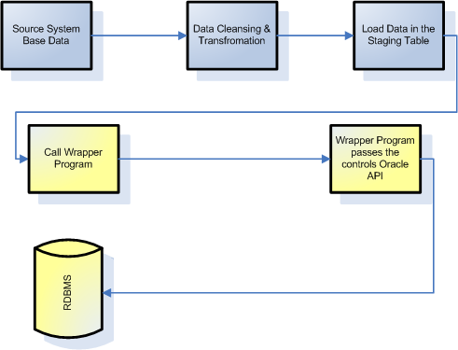
Migration Approach

Slide 38

"How do you know so much about everything? was asked of a very wise and intelligent man; and the answer was By never being afraid or ashamed to ask questions as to anything of which I was ignorant.“
- John Abbott

Slide 39
Thank You

